Slide 1
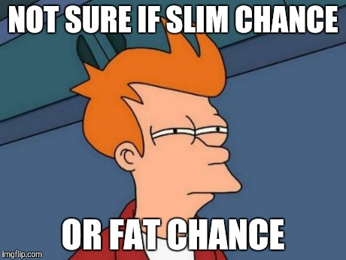

Slide 2
Contents
Glossary or Formula Page
Page
Date
Description
2
3

Slide 3
Tasks
24
7
30
Essential Question
Questions
Notes
Summary
4
5

Slide 4
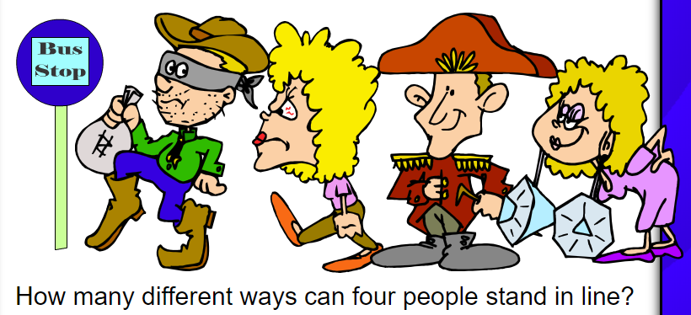
Warm up

Slide 5
Birthday Bazinga Activity
On a task page write down what you think the probability of two people in the room having the same birthday is
When directed by your teacher you will call out your birthday to the class
If you have the same birthday as someone else yell out “BAZINGA!”

Slide 6
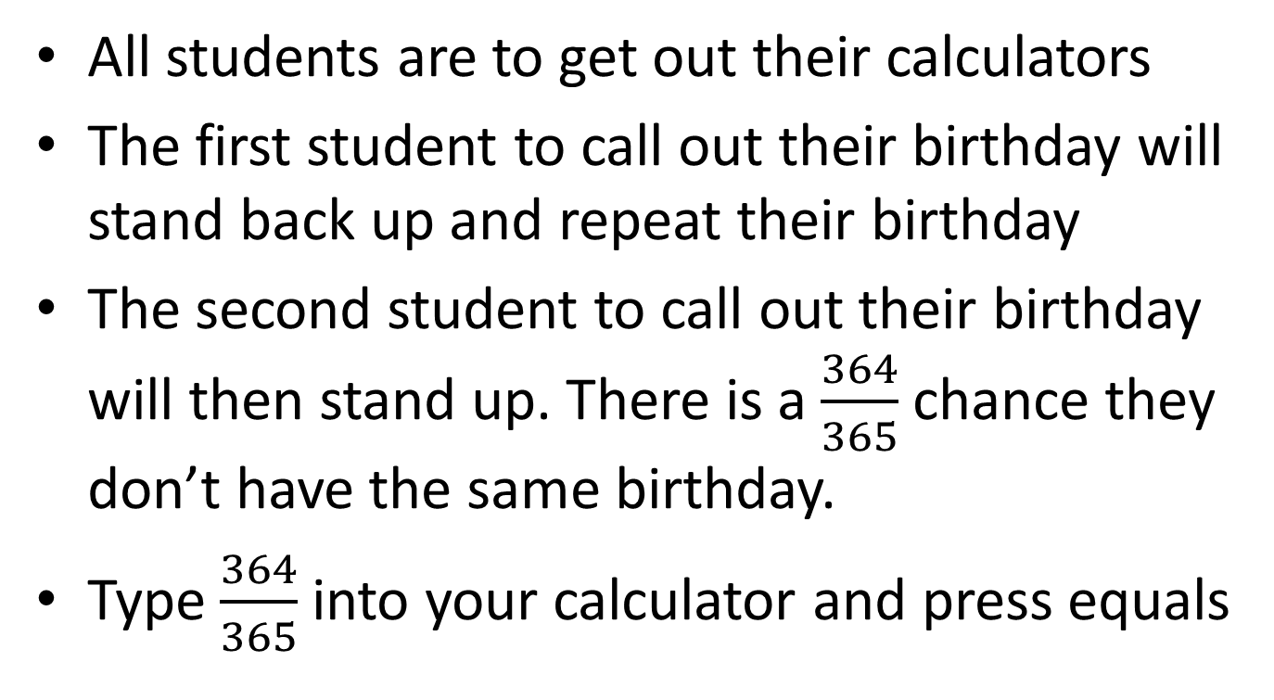
Birthday Bazinga Activity
All students are to get out their calculators
The first student to call out their birthday will stand back up and repeat their birthday
The second student to call out their birthday will then stand up. There is a $\frac{364}{365}$ chance they don’t have the same birthday.
Type $\frac{364}{365}$ into your calculator and press equals

Slide 7
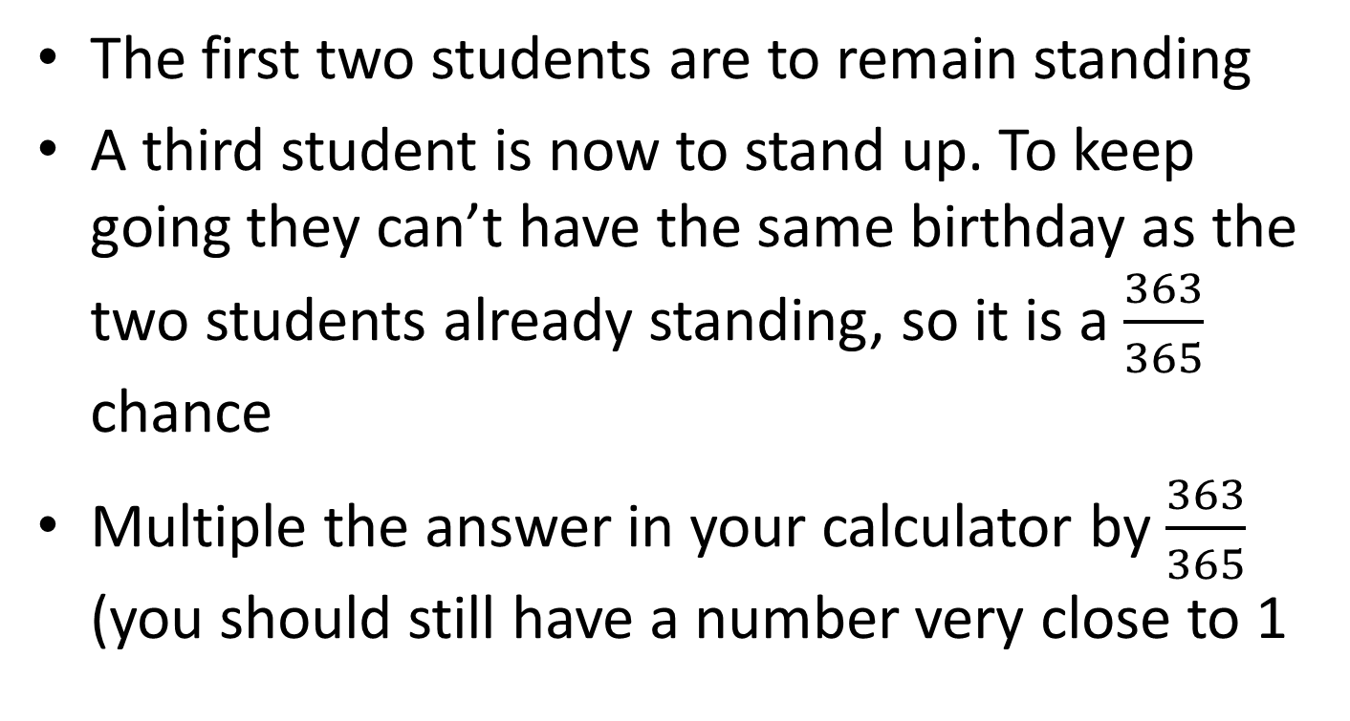
Birthday Bazinga Activity
The first two students are to remain standing
A third student is now to stand up. To keep going they can’t have the same birthday as the two students already standing, so it is a $\frac{363}{365}$ chance
Multiple the answer in your calculator by $\frac{363}{365}$ (you should still have a number very close to 1

Slide 8
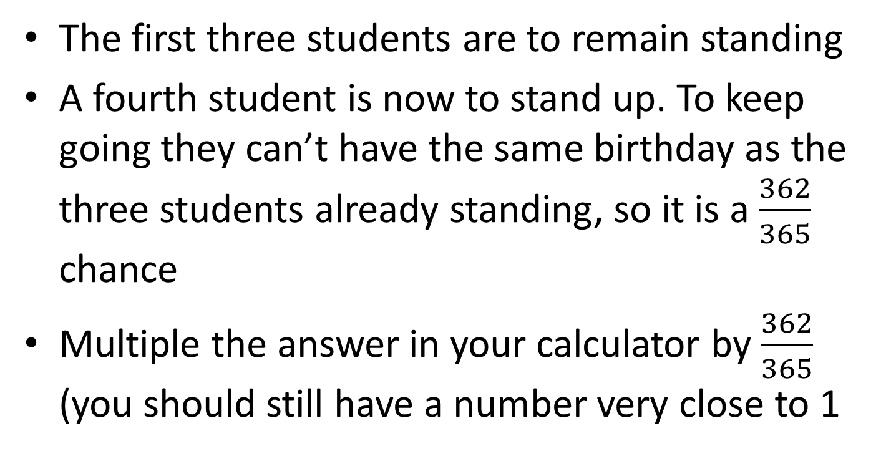
Birthday Bazinga Activity
The first three students are to remain standing
A fourth student is now to stand up. To keep going they can’t have the same birthday as the three students already standing, so it is a $\frac{362}{365}$ chance
Multiple the answer in your calculator by $\frac{362}{365}$ (you should still have a number very close to 1

Slide 9

Birthday Bazinga Activity
This pattern keeps going, do it for a total of 23 times, getting you to $\frac{343}{365}$
You should now have a probability in your calculator of 0.493

Slide 10
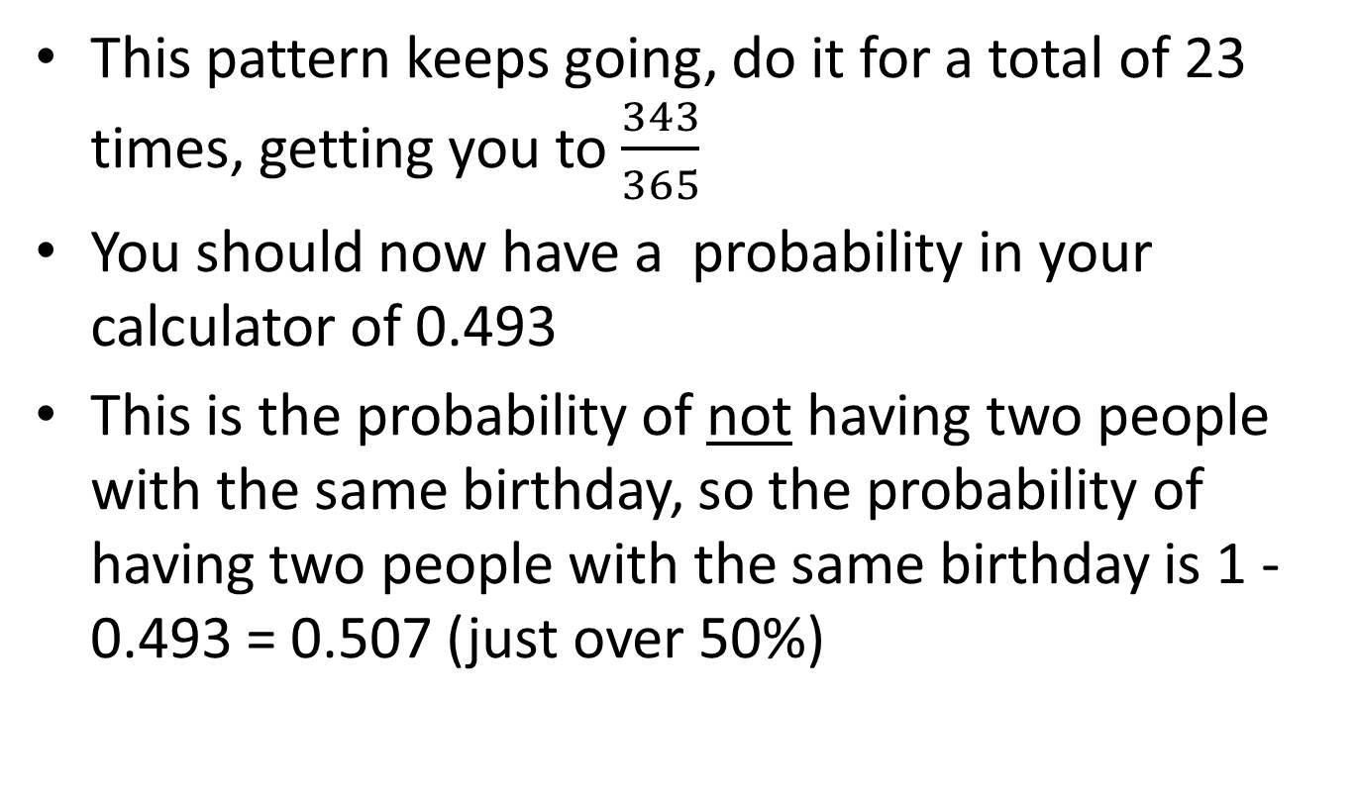
Birthday Bazinga Activity
This pattern keeps going, do it for a total of 23 times, getting you to $\frac{343}{365}$
You should now have a probability in your calculator of 0.493
This is the probability of not having two people with the same birthday, so the probability of having two people with the same birthday is 1 - 0.493 = 0.507 (just over 50%)

Slide 11
24
7
30
Date
Experimental Probability
EQ – How does not replacing something once drawn affect probability calculations?
What is Probability without Replacement
In some experiments, the sample space may change for the different events.
For example, a marble may be taken from a bag with 20 marbles and then a second marble is taken without replacing the first marble. The sample space for the second event is then 19 marbles instead of 20 marbles.
5

Slide 12
24
7
30
Date
Experimental Probability
EQ – How does not replacing something once drawn affect probability calculations?
What is Probability without Replacement
In some experiments, the sample space may change for the different events.
A jar consists of 21 sweets. 12 are green and 9 are blue. William picked two sweets at random.
Step 1: Draw the Probability Tree Diagram and write the probability of each branch. (Remember that the objects are not replaced)
Step 2: Look for all the available paths (or branches) of a particular outcome.
Step 3: Multiply along the branches and add vertically to find the probability of the outcome.
5

Slide 13
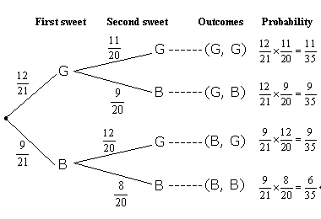
24
7
30
Date
Experimental Probability
EQ – How does not replacing something once drawn affect probability calculations?
A jar consists of 21 sweets. 12 are green and 9 are blue. William picked two sweets at random.
Step 1: Draw the Probability Tree Diagram and write the probability of each branch. (Remember that the objects are not replaced)
Step 2: Look for all the available paths (or branches) of a particular outcome.
Step 3: Multiply along the branches and add vertically to find the probability of the outcome.
5

Slide 14
24
7
30
Date
Experimental Probability
EQ – How does not replacing something once drawn affect probability calculations?
A jar consists of 21 sweets. 12 are green and 9 are blue. William picked two sweets at random.
Step 1: Draw the Probability Tree Diagram and write the probability of each branch. (Remember that the objects are not replaced)
Step 2: Look for all the available paths (or branches) of a particular outcome.
Step 3: Multiply along the branches and add vertically to find the probability of the outcome.
5

Slide 15
24
7
30
Date
Experimental Probability
EQ – How does not replacing something once drawn affect probability calculations?
A jar consists of 21 sweets. 12 are green and 9 are blue. William picked two sweets at random.
Step 1: Draw the Probability Tree Diagram and write the probability of each branch. (Remember that the objects are not replaced)
Step 2: Look for all the available paths (or branches) of a particular outcome.
Step 3: Multiply along the branches and add vertically to find the probability of the outcome.
5

Slide 16
24
7
30
Date
Experimental Probability
EQ – How does not replacing something once drawn affect probability calculations?
A jar consists of 21 sweets. 12 are green and 9 are blue. William picked two sweets at random.
Step 1: Draw the Probability Tree Diagram and write the probability of each branch. (Remember that the objects are not replaced)
Step 2: Look for all the available paths (or branches) of a particular outcome.
Step 3: Multiply along the branches and add vertically to find the probability of the outcome.
5

Slide 17
24
7
30
Date
Experimental Probability
EQ – How does not replacing something once drawn affect probability calculations?
Check that the sum of probabilities equals 1
1
5

Slide 18
24
7
30
Date
Experimental Probability
EQ – How does not replacing something once drawn affect probability calculations?
Check that the sum of probabilities equals 1
1
Find the probability that both sweets are blue
5

Slide 19

24
7
30
Date
Experimental Probability
EQ – How does not replacing something once drawn affect probability calculations?
Check that the sum of probabilities equals 1
1
Find the probability that both sweets are blue
5

Slide 20
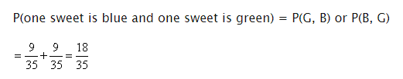
24
7
30
Date
Experimental Probability
EQ – How does not replacing something once drawn affect probability calculations?
Check that the sum of probabilities equals 1
1
Find the probability that one is blue and one is green
5

Slide 21
24
7
30
Date
Experimental Probability
EQ – How does not replacing something once drawn affect probability calculations?
Check that the sum of probabilities equals 1
1
Find the probability that one is blue and one is green
5

Slide 22
24
7
30
Date
Experimental Probability
EQ – How does not replacing something once drawn affect probability calculations?
Check that the sum of probabilities equals 1
1
Extension: Add a third sweet to be drawn and find:
Probability that all three are green
Probability that at least one is blue
5

Slide 23


24
7
30
Date
Experimental Probability
EQ – How does not replacing something once drawn affect probability calculations?
Check that the sum of probabilities equals 1
1
Extension: Add a third sweet to be drawn and find:
Probability that all three are green
Probability that at least one is blue
5

Slide 24
Notes Review
24, 7 ,30
Date
Title
Essential question
Notes complete
Notes complete with colour and diagrams
Questions completed
Contents page filed in
Formula page filled in

